Slide 1

Serial Peripheral Interface Protocol

Slide 2
Contents
What is SPI Interface
SPI Specification
Data Transmission
SPI MODES
Mode 0
Mode 1
Mode 2
Mode 3
SPI on Raspberry Pi using IOCTL
Registers used by the SPI
Advantages of SPI
Disadvantages of SPI
Applications

Slide 3
What is the SPI serial interface?
SPI is one of the most popular serial communication protocols.
SPI – serial peripheral interface is an interface bus commonly used to transmit and receive the data between microcontrollers and small peripherals. such as shift registers, sensors, displays, flash memory, etc.
Since it is synchronous communication, it uses a separate clock line and data lines. The interface was developed by Motorola in the mid-1980s.
One unique benefit of SPI is the fact that data can be transferred without interruption.
Any number of bits can be sent or received in a continuous stream.
With I2C and UART, data is sent in packets, limited to a specific number of bits. Start and stop conditions define the beginning and end of each packet, so the data is interrupted during transmission.

Slide 4
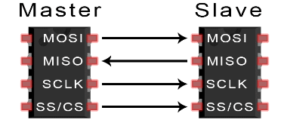
SPI Specification
An SPI – serial peripheral interface protocol system consists of one master device and one or more slave devices.
But in I2C, we can have one or more master devices and one or more slave devices. The master is providing the SPI clock and the slave is receiving the SPI clock from the master.
SPI needs 4 wires at least. But some of the recent day devices support 3 pin mode and 4pin modes also.
Data rate 10mbps.
MOSI – master out slave in MISO – master in slave out SCLK – serial clock SS/CS/CE – salve select/chip select/chip enable

Slide 5
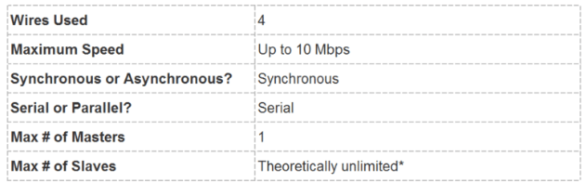
MOSI – Master out slave in is used to send the data from the master to the slave device.
MISO – Master in slave out is used to receive the data from the slave to the master device.
SCLK – Serial clock is the clock that is generated by the master device.
SS/CS/CE – Salve select/chip select/chip enable line is used to select the slave device in the SPI bus interface.
SPI protocol is a full-duplex as this protocol has separate pins for incoming data and outgoing data. So, we can transmit and receive the data at the same time.
When you increase the number of slaves, then the slave select pin also increases.

Slide 6
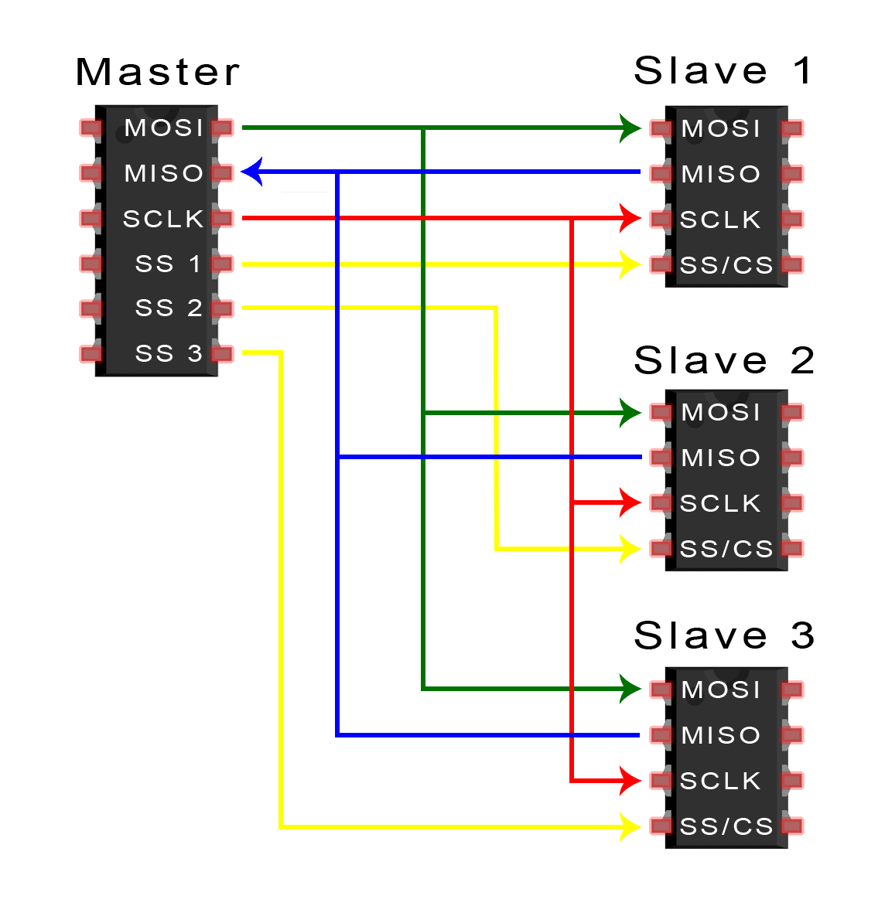
There are two ways to connect multiple slaves to the master.
If the master has multiple slave select pins, the slaves can be wired in parallel like this:
When you increase the number of slaves, then the Slave Select pin also increases.
SI
SO
SI
SO
SI
SO

Slide 7
Is there any way to reduce the pins that are used for the SPI communications?
Yes, there are certain scenarios we can apply to reduce the pins.
When you have only one slave, that only gets the data from the master and it won’t send anything to the master, then you can leave the MISO pin.
We made two modifications to the normal SPI connections.
Removed the other SS/CS pins and connected all the slave’s SS/CS pin to the one SS/CS pin of the master.
2. All the slave’s output (SO) is connected to the next slave’s input (SI) and the last slave’s output is connected to the master’s MISO.
If only one slave select pin is available, the slaves can be daisy-chained like this

Slide 8
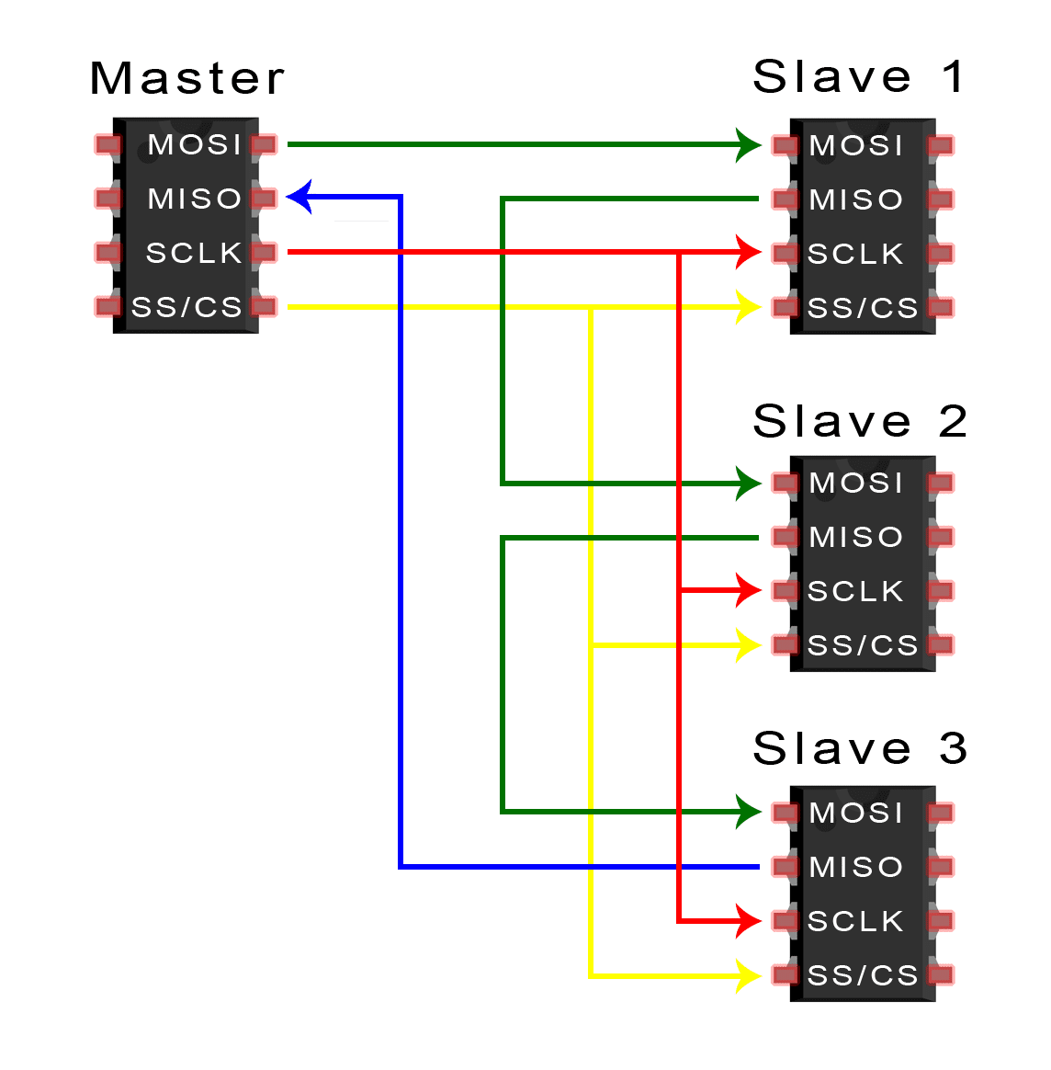
DAISY CHAIN
Slave 1’s input (SI) is directly connected to the master’s MOSI.
When the master transmits the data, it will be stored in slave 1’s internal shift register for the first 8 clock cycles.
Then in the next 8 clock cycles, slave 1 will be sent out the data from its internal shift register through its output (SO).
As slave 1’s output (SO) line is connected to slave 2’s input (SI), slave 2 will receive the data in the next 8 clock cycles.
And this process continues as long as the master generating the clocks and SS/CS line is low.
SI
SO
SI
SO
SI
SO

Slide 9
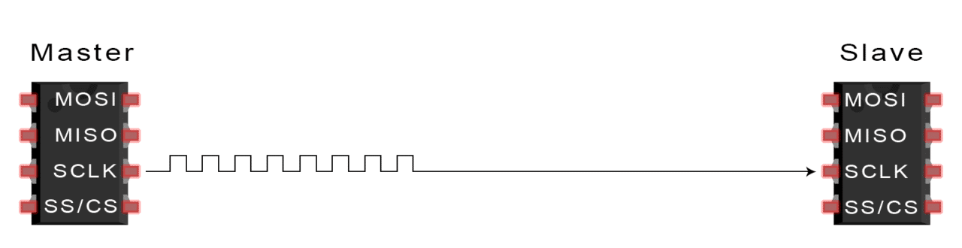
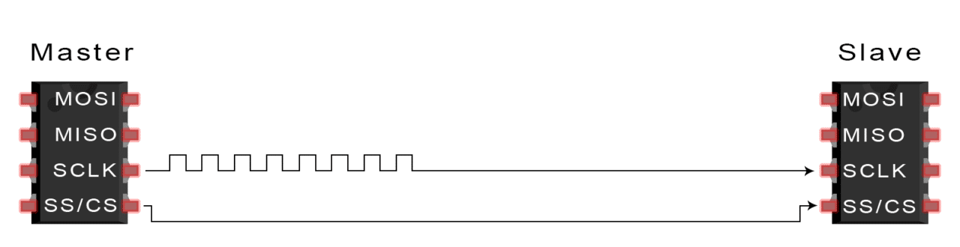
Data Transmission
The master outputs the clock signal
2. The master switches the SS/CS pin to a low voltage state, which activates the slave

Slide 10
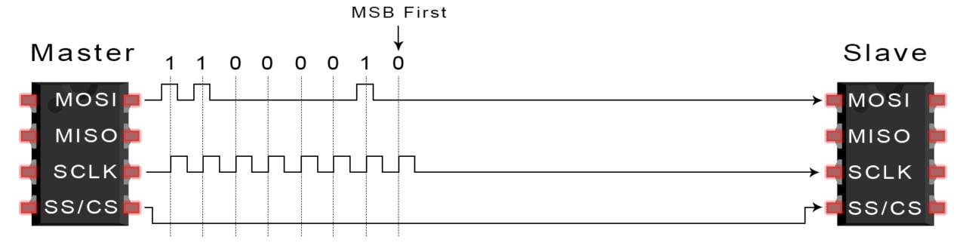
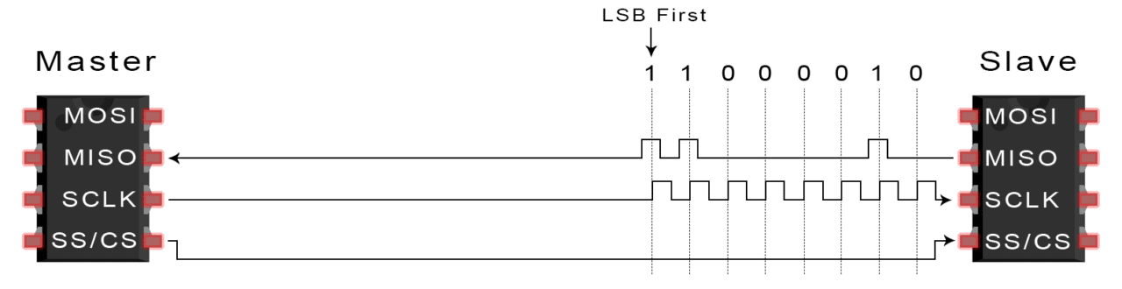
3. The master sends the data one bit at a time to the slave along the MOSI line. The slave reads the bits as they are received
4. If a response is needed, the slave returns data one bit at a time to the master along the MISO line. The master reads the bits as they are received:

Slide 11
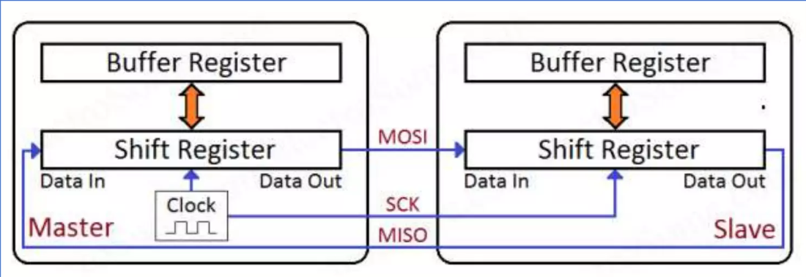
The master sends data to the slave bit by bit, in serial through the MOSI line. The slave receives the data sent from the master at the MOSI pin. Data sent from the master to the slave is usually sent with the most significant bit first.
The slave can also send data back to the master through the MISO line in serial. The data sent from the slave back to the master is usually sent with the least significant bit first.
SPI Data Transmission – Buffer & Shift Register
Buffer act as interface between processor(programmer) and SPI.
Buffer register will avoid all glitches that can happen if we try to read , write to shift register directly while transmission taking place

Slide 12
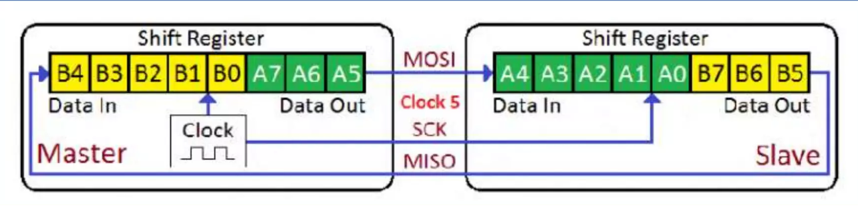
SPI – Shift Register
Usually shift register won’t be directly accessible so, if we need to transmit data, we will write it to the buffer register.so,
It is automatically written to shift register when it is free and transmission will start.
Similarly data is received in the shift register is automatically transferred to buffer register once the reception is complete. We can easily read from it. Thus we can avoid glitches in buffer registers.

Slide 13
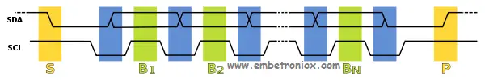
In the above image, the yellow color is START and STOP condition.
Blue colors are where the data is being changed when SCL is Low.
And the Green colors are where the data is read by the slave or master when SCL is High.
these data changing and sampling place is fixed in the I2C. But in SPI, it is not fixed.
It is flexible and the CPOL and CPHA are used to tell the master and slave that when to sample the data.
The clock polarity (CPOL) determines the initial state of the clock pin (SCLK). If CPOL is 0 means then the SCLK line’s initial state is low, and if CPOL is 1 means the SCLK line’s initial state is high.
The clock phase (CPHA) determines the edge. If CPHA is 0 then it means the leading edge (1st edge), and if CPHA is 1, then it means the trailing edge (2nd edge). These edges can be high to low or low to high.

Slide 14
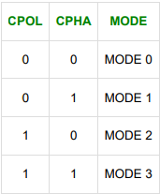
SPI Modes
In addition to setting the clock frequency, the master must also configure the clock polarity and phase with respect to the data. Clock polarity (CPOL) and clock phase (CPHA) are the two parameters that are used to form four unique modes to provide flexibility in communication between master and slave.

Slide 15
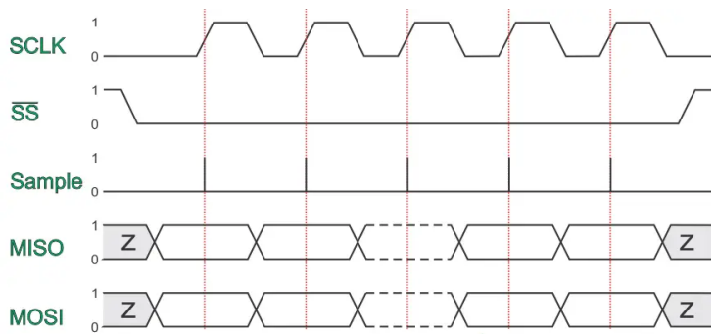
MODE 0
In this mode, CPOL is 0 and CPHA is also 0. So, the SCLK starts as low and the data will be sampled at the first edge
The data must be available before the first clock signal rising. The clock idle state is LOW. The data on MISO and MOSI lines must be stable while the clock is high and can be changed when the clock is low. The data is captured on the clock’s low-to-high transition and can be propagated on high-to-low clock transition.

Slide 16
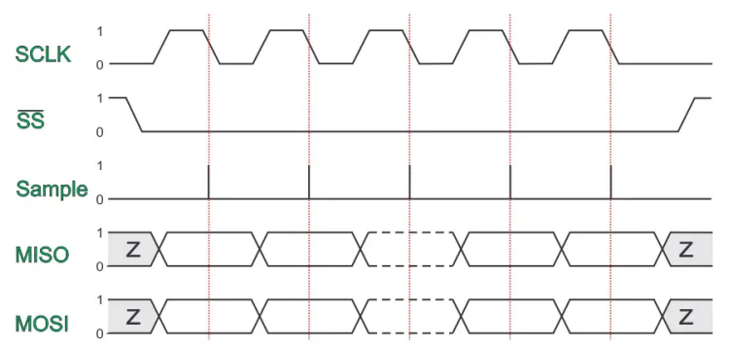
MODE 1
In this mode, CPOL is 0 and CPHA is also 1. So, the SCLK starts as low and the data will be sampled at the second edge.
The first clock signal rising can be used to prepare the data. The clock idle state is LOW. The data on MISO and MOSI lines must be stable while the clock is low and can be changed when the clock is high. The data is captured on the clock’s high-to-low transition and propagated on low-to-high clock transition.

Slide 17
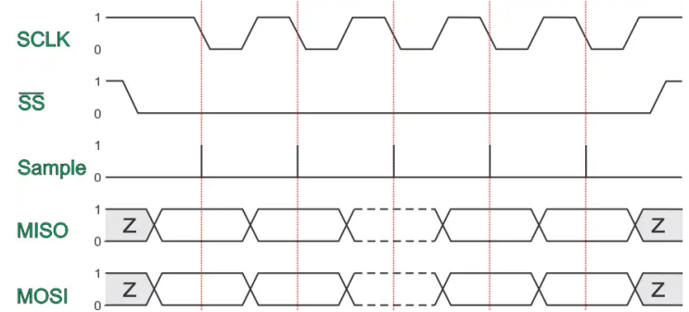
MODE 2
In this mode, CPOL is 1 and CPHA is also 0. So, the SCLK starts as high and the data will be sampled at the first edge
The data must be available before the first clock signal falling. The clock idle state is HIGH. The data on MISO and MOSI lines must be stable while the clock is low and can be changed when the clock is high. The data is captured on the clock’s high-to-low transition and propagated on low-to-high clock transition.

Slide 18
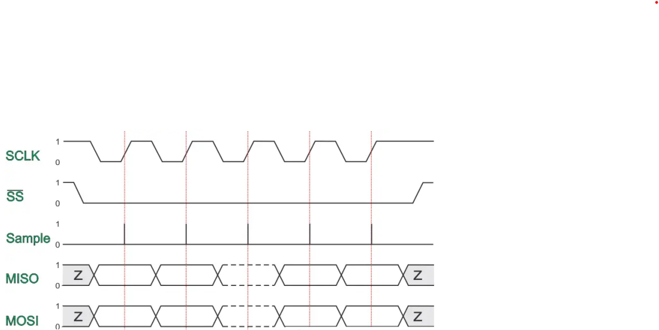
MODE 3
In this mode, CPOL is 1 and CPHA is also 1. So, the SCLK starts as high and the data will be sampled at the second edge.
The first clock signal falling can be used to prepare the data. The clock idle state is HIGH. The data on MISO and MOSI lines must be stable while the clock is high and can be changed when the clock is low. The data is captured on the clock’s low-to-high transition and propagated on high-to-low clock transition.

Slide 19
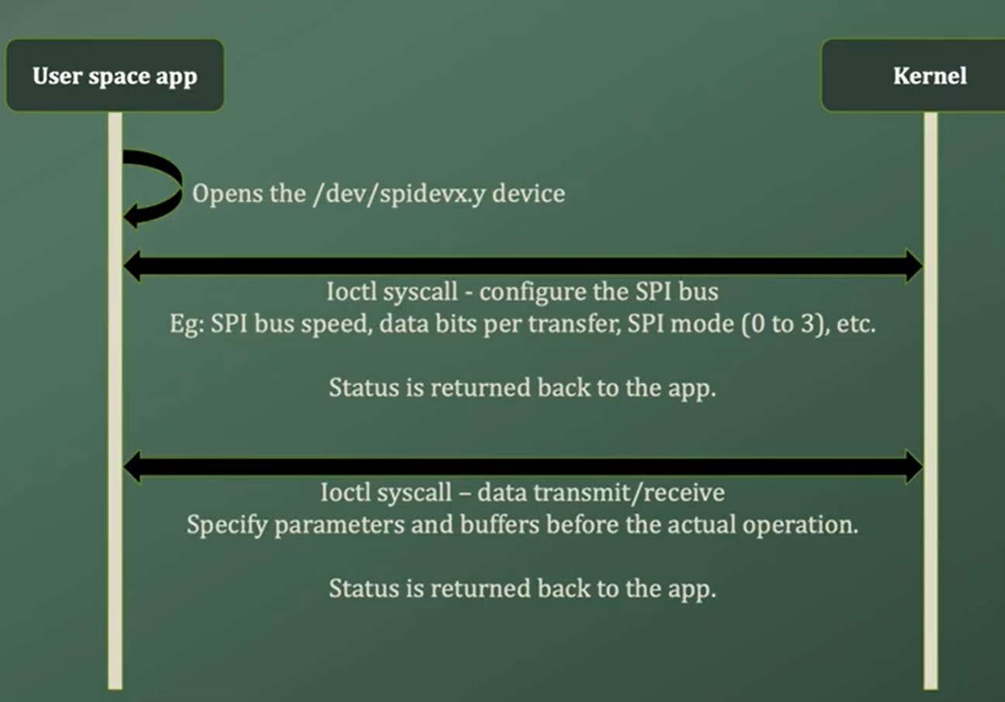
SPI on Raspberry Pi using IOCTL
SPI is used in users space with the help of spidev

Slide 20
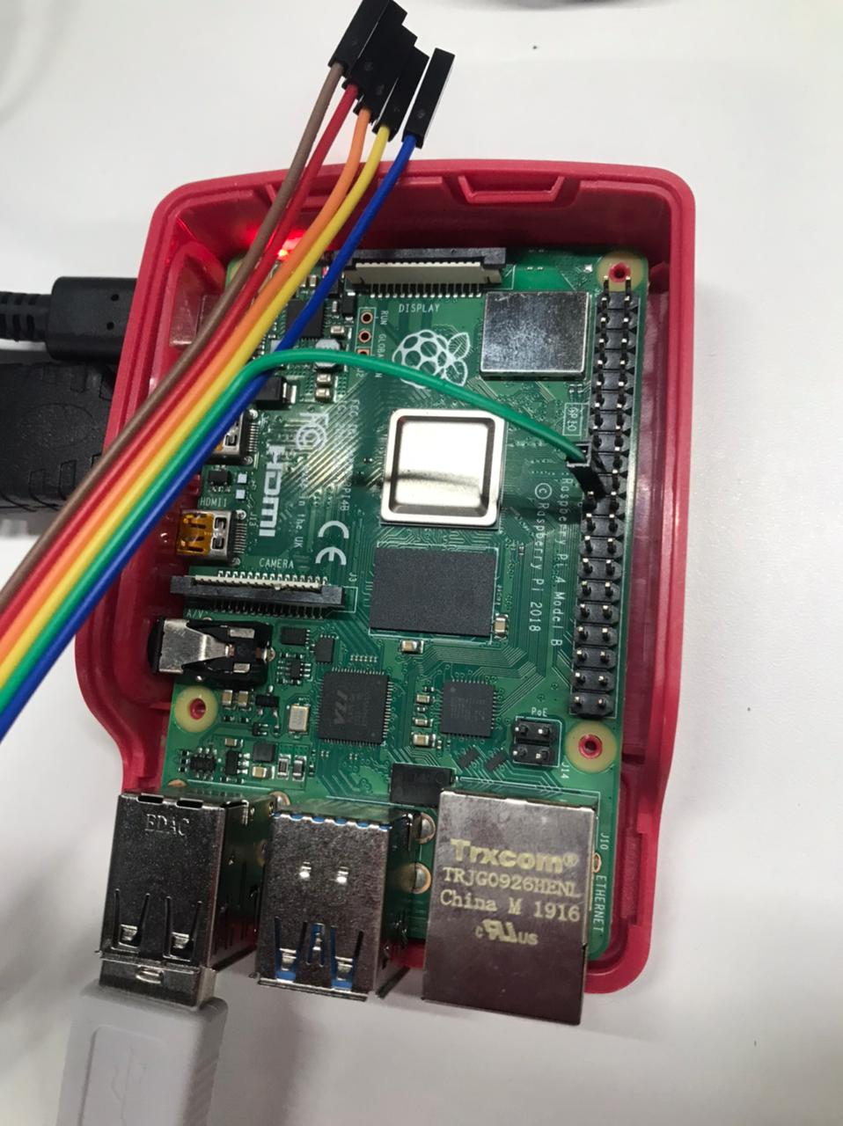
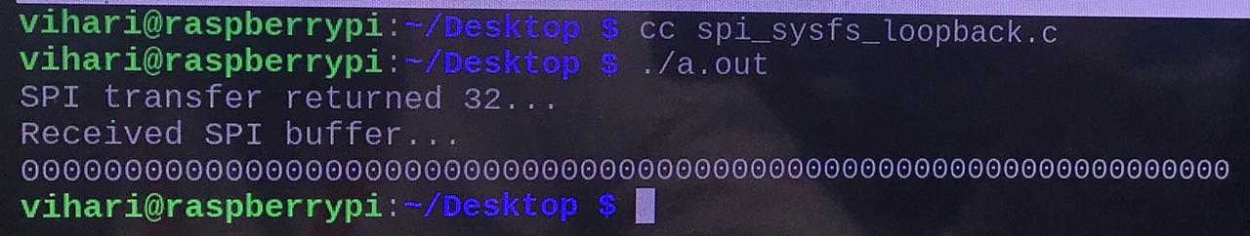
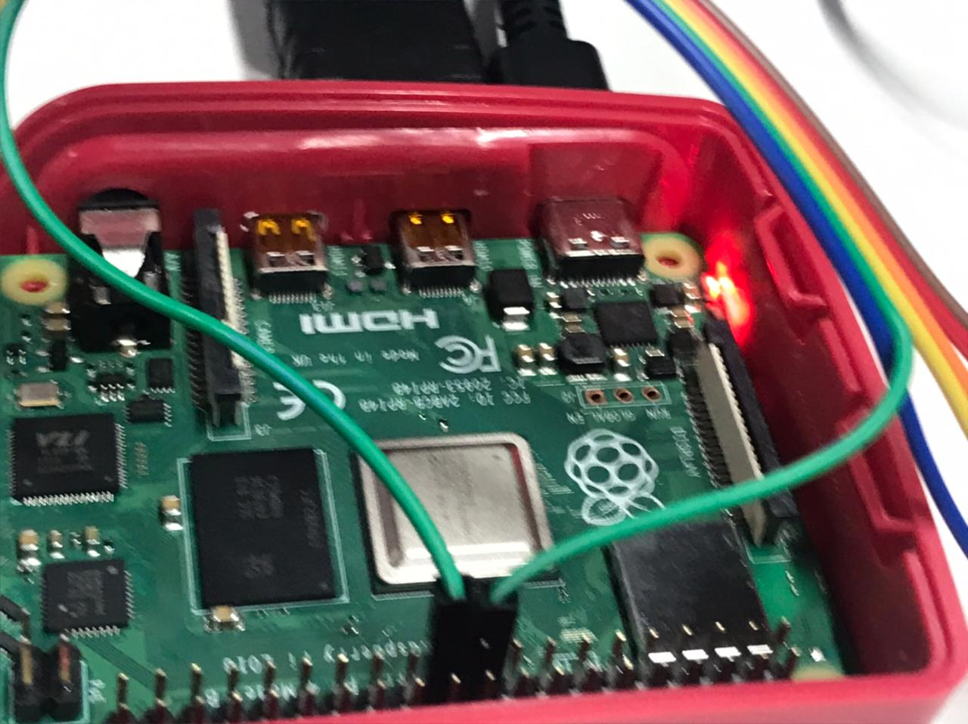
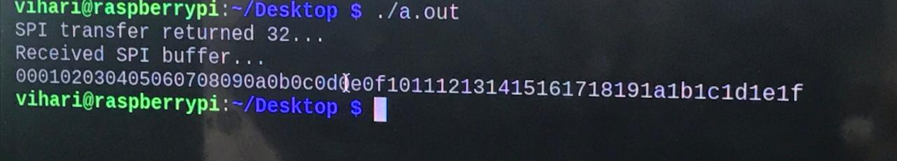

Slide 21
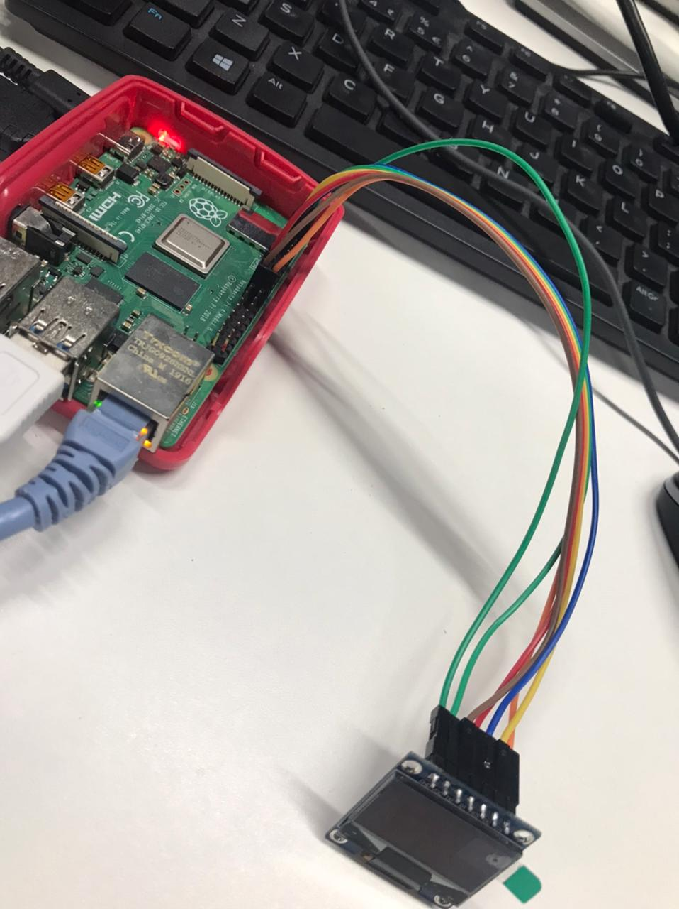
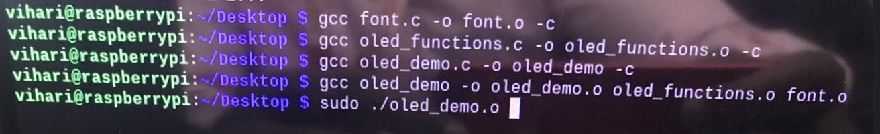

Slide 22
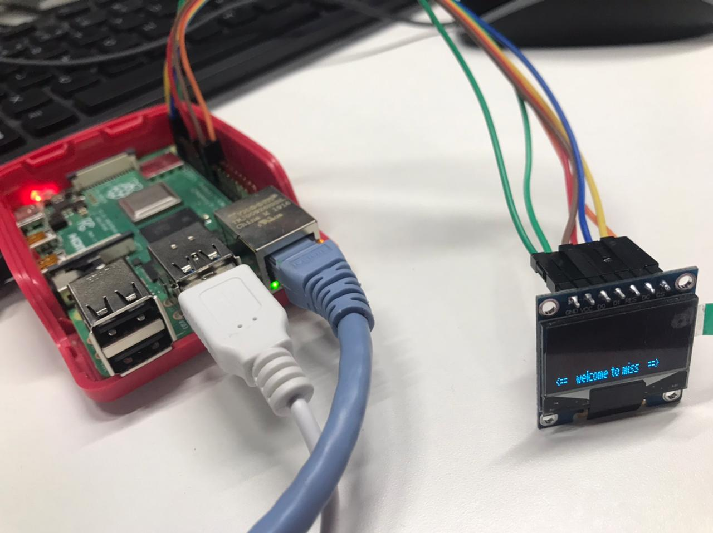

Slide 23
Writes to the Reserved Register are ignored.
Reading from Reserved Register returns all zeros.
Registers used by the SPI
USE | Access
SPI Control Register1(SPICR1) | Read/Write
SPI Control Register2(SPICR2) | Read/Write
SPI Baud Rate Register(SPIBR) | Read/Write
SPI Status Register(SPISR) | Read
Reserved
SPI Data Register(SPIDR) | Read/Write
Reserved
Reserved

Slide 24
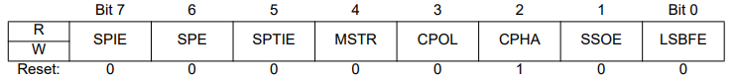
SPI Control Register1(SPICR1)
7) SPIE – SPI Interrupt Enable Bit
A hardware interrupt is requested when either the receive buffer is full represented by Receive Buffer Full Flag(SPRF=1) in the SPI Status register or when the slave select of the master MCU is pulled low causing a mode fault (MODF=1)
1=SPI interrupts enabled.
0=SPI interrupts disabled.
6) SPE – SPI System Enable Bit
This bit enables SPI System and dedicates the SPI port pin to SPI system functions.
1=SPI enabled , port pins are dedicated to SPI functions.
0=SPI disabled(low power consumption)

Slide 25
5) SPTIE – SPI Transmit Interrupt Enable
This bit enables CPU interrupt requests, to be generated when a byte transfers from the transmit data register to the shift register.
1= SPTEF interrupt enabled (if SPTEF flag of status register is set)
0= SPTEF interrupt disabled
4) MSTR – SPI Master/Slave Mode Select bit
This bit selects, if the SPI operates in master or slave mode.
1= SPI is in Master mode
0= SPI is in Slave mode
3) CPOL – SPI Clock Polarity Bit
This bit selects an inverted or non-inverted SPI clock . To transmit data between SPI modules.
1=clock is high .
0=clock is low.

Slide 26
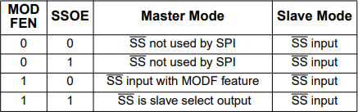
2) CHPA – SPI Clock Phase bit
This bit is used to select the SPI clock format.
1= Sampling of data occurs at even edges(2,4,6,…,16) of the SCK clock
0= Sampling of data occurs at odd edges(1,3,5,…,15) of the SCK clock
1) SSOE – Slave Select Output Enable
The SS Output feature is enabled only in master mode, if MODFEN(Mode Fault Enable Bit) is set in SPICR2 .

Slide 27
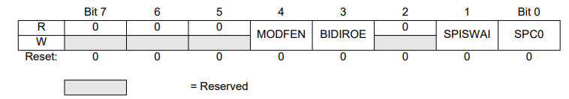
0) LSBFE – SPI LSB-First Enable
This bit does not affect the position of the MSB and LSB in the data register.
1= Data is transferred least significant bit first
0= Data is transferred most significant bit first
SPI Control Register 2 (SPICR2)
-> bit 7 , bit 6 , bit 5 , bit 2 are reserved bits.
4) MODFEN- Mode Fault Enable Bit
If the SPI is in Master mode and MODFEN is cleared, then the ss port pin is not used by the SPI.
In Slave mode, the ss is available only as an input regardless of he value of MODFEN.
1= ss port pin with MODF feature
0= ss port pin is not used by the SPI

Slide 28
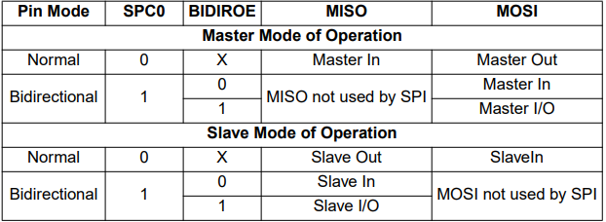
3) BIDIROE — Output enable in the Bidirectional mode of operation
This bit controls the MOSI and MISO output buffer of the SPI, when in bidirectional mode of operation . In master mode this bit controls the output buffer of the MOSI port, in slave mode it controls the output buffer of the MISO port
1 = Output buffer enabled
0 = Output buffer disabled
1) SPISWAI — SPI Stop in Wait Mode Bit
This bit is used for power conservation while in wait mode.
1 = Stop SPI clock generation when in wait mode
0 = SPI clock operates normally in wait mode
0) SPC0 — Serial Pin Control Bit 0
This bit enables bidirectional pin configurations or Full-duplex mode is enabled.

Slide 29
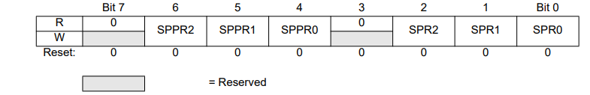
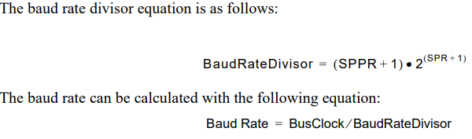
SPI Baud Rate Register
SPPR2–SPPR0 — SPI Baud Rate Preselection Bits
SPR2–SPR0 — SPI Baud Rate Selection Bits
These bits specify the SPI baud rates as shown in the table below

Slide 30
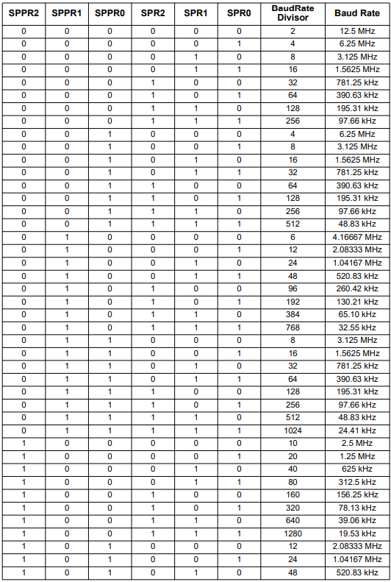
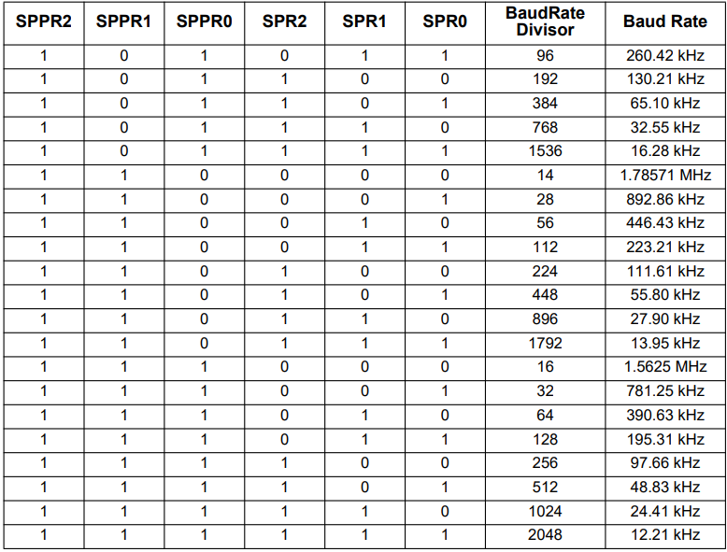

Slide 31
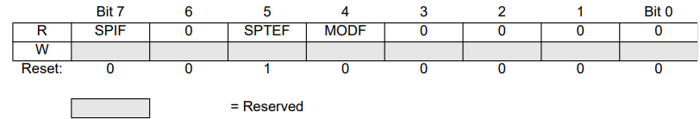
SPI Status Register
7) SPIF – SPIF Interrupt Flag
This bit is set after a received data byte has been transferred into the SPI Data Register. This bit is cleared by reading the SPISR register (with SPIF set) followed by a read access to the SPI Data Register.
1 = New data copied to SPIDR
0 = Transfer not yet complete
5) SPTEF – SPI Transmit Empty Interrupt Flag
This bit indicates that the transmit data register is empty
1= SPI Data register empty
0= SPI Data register not empty
4) MODF – Mode Fault Flag
This bit is set if the SS input becomes low while the SPI is configured as a master and mode fault detection is enabled.
1= Mode fault has occurred
0= Mode fault has not occurred.

Slide 32
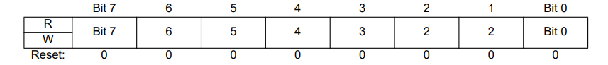
SPI Data Register
The SPI Data Register is both the input and output register for SPI data.
A write to this register allows a data byte to be queued and transmitted.
For a SPI configured as a master, a queued data byte is transmitted immediately after the previous transmission has completed.
The SPI Transmitter Empty Flag SPTEF in the SPISR register indicates when the SPI Data Register is ready to accept new data.
Received data in the SPIDR is valid when SPIF is set.
If SPIF is cleared and a byte has been received, the received byte is transferred from the receive shift
register to the SPIDR and SPIF is set.

Slide 33
SPI DEVICE DRIVER
Enable SPI in the Raspberry PI
In order to write the SPI driver, we have to enable the SPI bus. In this tutorial, we are using SPI 1. To enable SPI 1, please add the below line in the /boot/config.h.
dtoverlay=spi1-1cs,cs0_spidev=disabled
The above line enables the SPI 1 and it disables the SPIDev application. So that, we can use the SPI 1 bus. You can refer to this if you have any doubt.
SPI Subsystem in Linux
The SPI device driver in Linux is mainly managed by the SPI subsystem, and it is divided into 3 sections.
SPI Core
SPI Controller Driver
SPI Protocol Driver

Slide 34
SPI Core
The SPI core provides APIs for the definition of core data structures, registration, and cancellation management of SPI controller drivers and device drivers. It is a hardware platform-independent layer, that shields the differences of the physical bus controller downwards and defines a unified access strategy and interface. It provides a unified interface upwards. So that, the SPI device driver can send and receive data through the SPI bus controller. In Linux kernel, the SPI core code is located in kernel/drivers/spi/spi.c.
SPI Controller Driver
The SPI Controller driver is the platform-specific driver. So, each SoC manufacturer has to write this driver for their platform or MCU. controllers These SPI controller drivers may be built into System-On-Chip processors, and often support both Master and Slave roles. These drivers touch hardware registers and may use DMA or they can be GPIO bit bangers, needing just GPIO pins. Its responsibility is to implement a corresponding read and write method for each SPI bus in the system. Physically, each SPI controller can connect several SPI slave devices. When the system is turned on, the SPI controller driver is loaded first. A controller driver is used to support the reading and writing of a specific SPI bus. So, this SPI controller driver is similar to the adapter/bus driver in the I2C. You can see the all SPI controller driver in kernel/drivers/spi/.
SPI Protocol Driver
Each SPI bus controller may connect to multiple slave devices. This driver is used to communicate to specific devices through the SPI bus. This is similar to the I2C client driver.

Slide 35
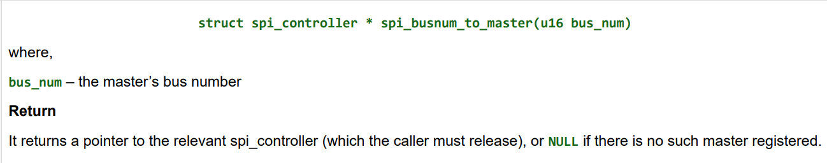
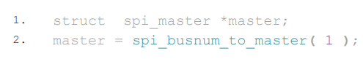
Get the SPI Controller driver
First, you need to get the controller driver. To do that, you can use the below API. Before using that API, you need to know which SPI bus you are using. In this example, I am using the SPI Bus 1.
Example

Slide 36
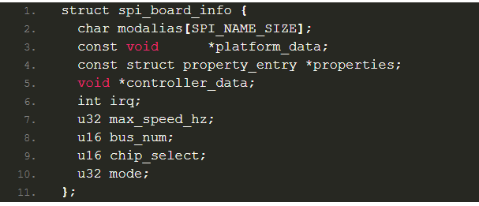
Add the slave device to the SPI Controller
In this step, you need to create a spi_board_info structure that has the slave device’s details.
modalias – This string is used to identify the driver.
platform_data – the particular data stored there is driver-specific.
properties – Additional device properties for the device.
controller_data – some controllers need hints about hardware setup, e.g. for DMA.
irq – Interrupt number max_speed_hz – Maximum speed that slave supports.
Refer to the slave’s datasheet.
bus_num– SPI bus number that slave is going to connect.
chip_select – Chip select that you want to use.
mode – SPI mode. Refer to the slave’s datasheet.

Slide 37
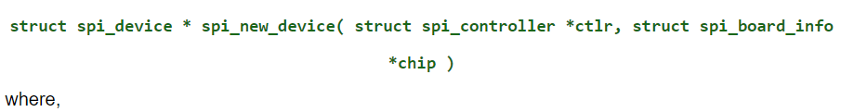
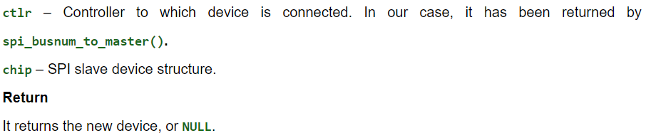
Once you have filled this structure, then you can use the below API to add the slave device to the SPI controller driver.
This spi_new_device() is enough as this function handles the spi_alloc_device() and spi_add_device() inside.

Slide 38
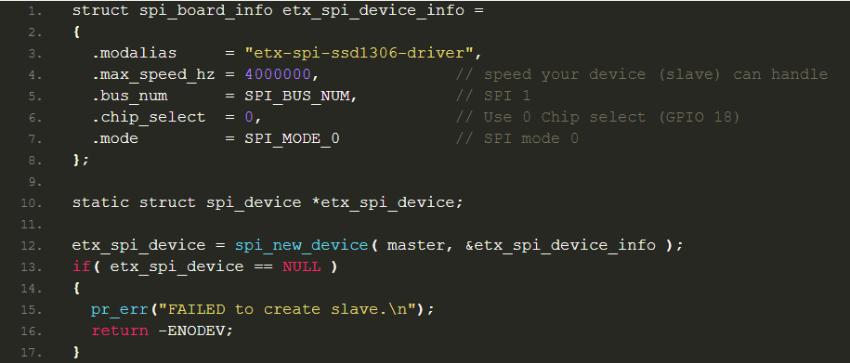
Example

Slide 39
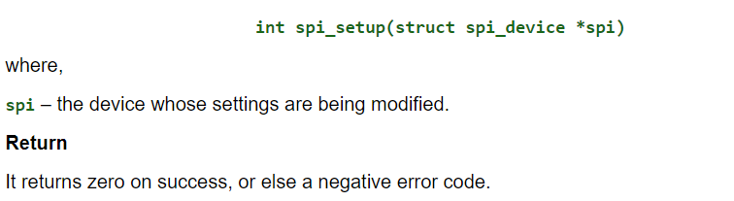
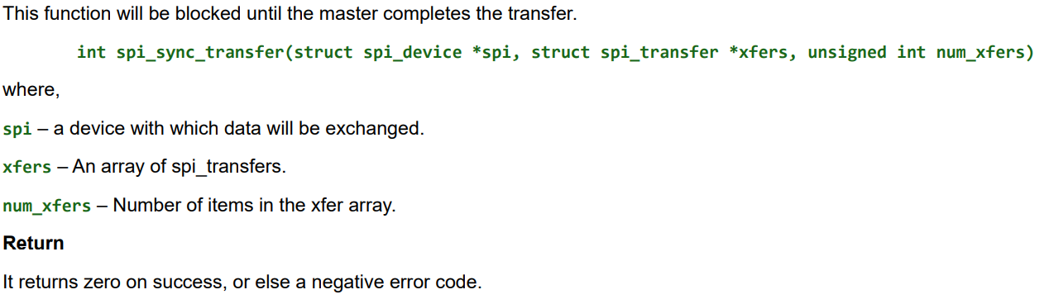
Configure the SPI
Till now, we have added the slave device to the controller driver. If we change any mode or clock frequency, then we have to call this below API to take effect on the bus.
Message Transfer
We have done with our initialization. Now we can transfer the data using the below APIs.

Slide 40
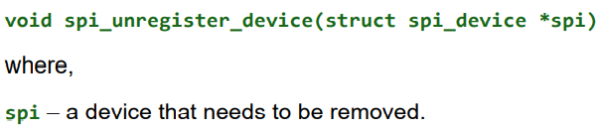
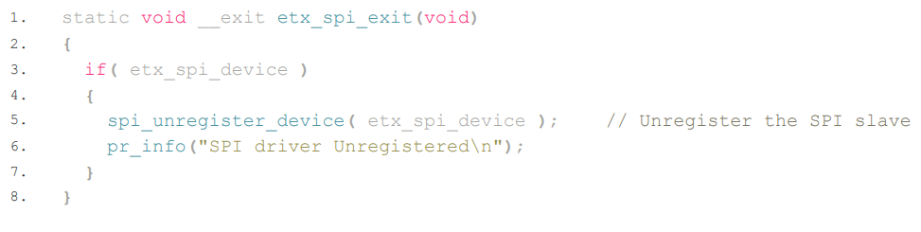
Remove the device
Using the below API, you can unregister the slave device.
Example

Slide 41
SSD1306 OLED Memory Map
Regardless of the size of the OLED module, the SSD1306 driver has a built-in 1KB Graphic Display Data RAM (GDDRAM) for the screen which holds the bit pattern to be displayed. This 1K memory area is organized into 8 pages (from 0 to 7). Each page contains 128 columns/segments (block 0 to 127). And each column can store 8 bits of data (from 0 to 7).
8 pages x 128 segments x 8 bits of data = 8192 bits = 1024 bytes = 1KB memory
Data in SSD1306 OLED
There are two types of data that we can send to the SSD1306 OLED.
1. Command
2. Data to be written into the GDDRAM
The command is nothing but, tells the LED to do some operations like a scroll, increases the brightness, etc.
Each page contains 8 rows. So, a total of 64 rows will be present in the SSD1306’s GDDRAM (Graphics Display Data RAM).

Slide 42
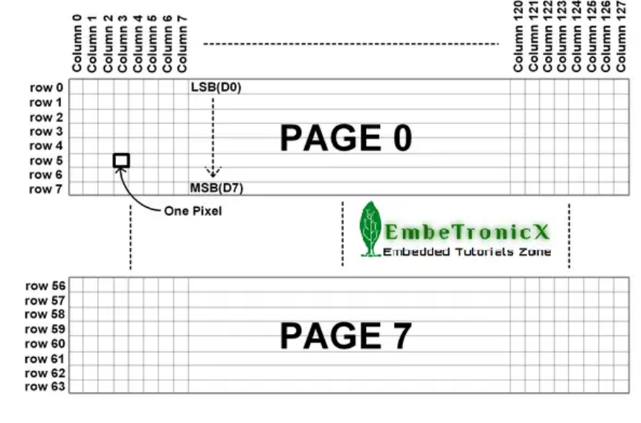
As per our understanding, it has 128 columns and 64 rows. So the size of GDDRAM is 128 x 64 bits and it is divided into eight pages, from PAGE0 to PAGE7

Slide 43
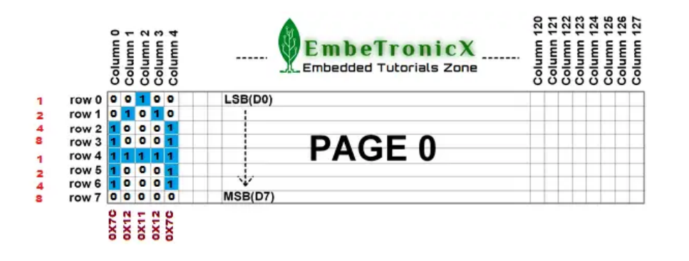
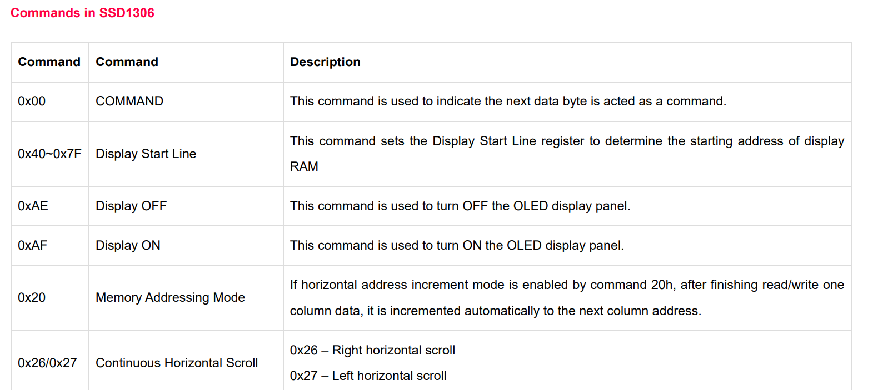
we are going to write one character in 5×8, In that, I have taken Page 0’s row 0 to row 7 and column 0 to column 4 to explain how to write our characters.

Slide 44
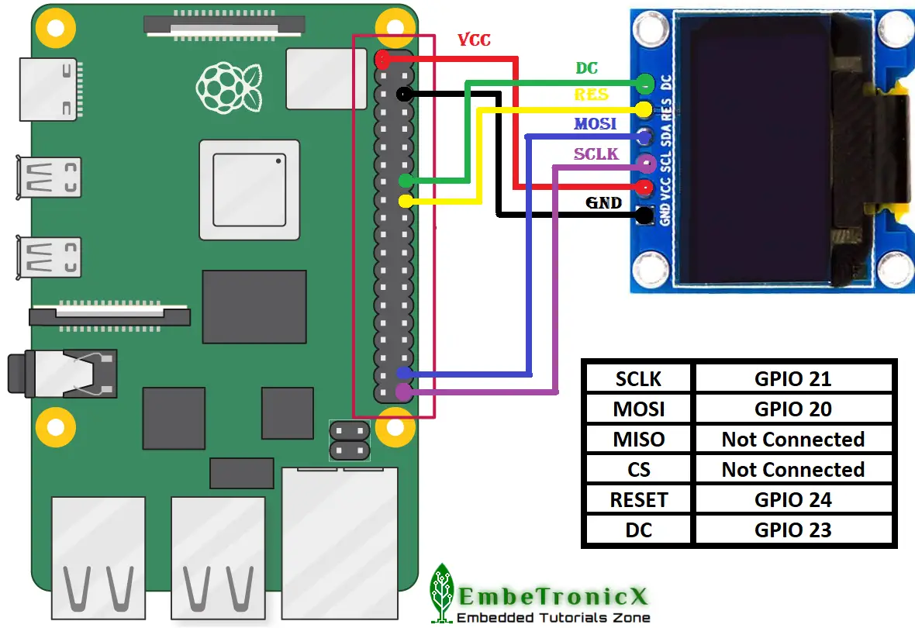
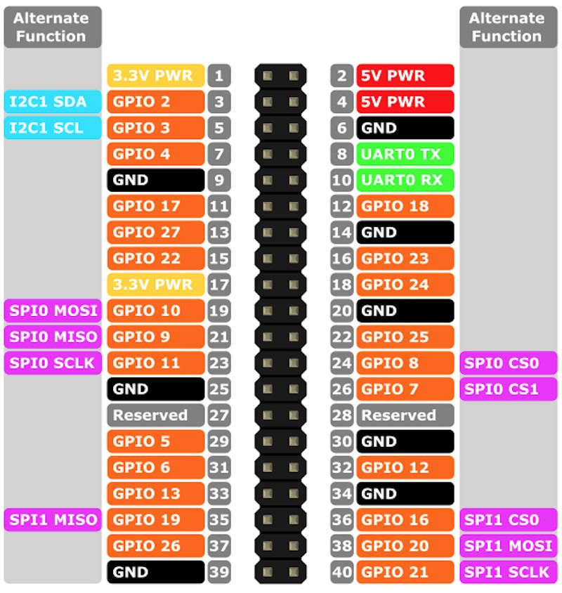

Slide 45
Advantages of SPI
Low power consumption compared to I2c
no need of pull up resistor (2k ohm).
clock gating
It’s way faster than asynchronous serial communication and I2C (almost twice as fast).
No start and stop bits, so the data can be streamed continuously without interruption.
No slave addressing mechanism like i2c.
It has separate MISO and MOSI lines, so data can be sent and received at the same time (full duplex).
Not limited to 8-bit data.
The received hardware (slave) can be a simple shift register.
Disadvantages of SPI
It requires more lines (wires) than other communication methods. (UART and I2C only require 2 lines).
There is no acknowledgment to inform that data has been successfully transferred like i2c and no error detection protocol is defined.
It only allows for a single master.

Slide 46
The master must control all communications (slaves can’t talk directly to each other).
It usually requires separate cs lines to each peripheral, which can be problematic if numerous slaves are needed.
Applications
SPI is used to talk to a variety of peripherals, such as.
Sensors:(Temperature, Pressure, Humidity)
Converters(ADC,DAC).
Memories(EEPROM,RAM’S).
Real Time Clocks.
Potentiometers, LCD controllers, UART’s, USB controller, CAN controller, amplifiers

